Slide 1
SVD and PCA
Dealing with Data, Class 6

Slide 2
Announcements
HW5 (last one) is out now and it is OPTIONAL
We won’t be collecting it
We want you to be thinking about your projects over break...
...but we did want to give you some practice with SVD if you wanted it
Project Guidelines Document posted now!
More info on that shortly...
HW3 is graded!

Slide 3
Agenda
More info about projects
Recap
PCA/SVD:
The Model
Fitting the model
Interpreting the model
Example
(If time) Missing data

Slide 4
Projects!

Slide 5
Projects!
This class has a final project!
Two broad classes of projects:
Do something with data!
Learn a new way to deal with data!
All projects have two final deliverables:
A presentation (December 12; you can present Dec. 5 if you want to).
A write-up (5 to 15 pages, due December 19 at 11:59 pm local time on Blackboard)
You can work in groups of up to 4 (larger groups are encouraged!)

Slide 6
Project Type #1: do something with data!
Think of a question!
Find a dataset to help you answer the question*,**
Use (at least one) technique we discussed in class to answer the question
Write-up what you were interested in and what you found!
* There are many interesting questions that are very hard to answer with the data that exists
** There will inevitably be some iterating back and forth to get a match between the feasibility of the question and the data

Slide 7
Ideas of places to look for data See document on Blackboard for links
World Values Survey
We’ll see this today!
Panel Study of Income Dynamics
We saw this in homework 1
Integrated Public Use Microdata Series
We saw one dataset from this on homework 3
Inter-university Consortium for Political and Social Research
Thousands (or more?) of datasets
UCI Machine Learning Repository
Even more datasets!
Be creative!

Slide 8
Project Type #2: learn a new way to deal with data!
We only scratched the surface about ways of dealing with data!
Pick some technique we didn’t discuss (too much).
Learn more about it!
Explain it to us!
We are NOT looking for pages/slides of math
We are looking for intuition about the core idea and some simple “worked examples” that show the core idea
Optionally, try it out on some data!
The datasets from HW might be a good place to start.

Slide 9
More Detailed Timeline 1
Project Proposal: Due before class on November 21 (two weeks!)
Tell us who you are working with
Tell us what project you are interested in doing
Give us some details so we can see if you are on the right track
PLEASE: reach out to us sooner rather than later so that we can help you!
(See document on Blackboard for more details on project proposal)
We will send you feedback by November 24

Slide 10
More Detailed Timeline 2
November 28 (class 8):
Very short in-class presentations!
You should have essentially two slides:
If a “do something with data” project:
Slide 1: What’s the question?
Slide 2: Dataset and technique you want to use
If a ”learn a technique” project:
Slide 1: Motivate why this technique
Slide 2: Very simple example of the problem the technique deals with, or idea of the technique

Slide 11
More Detailed Timeline 3
December 12: in class presentations
We will have more to say on what these should look like closer to the date
This will depend on how many groups there end up being
Note: If you want to present earlier on December 5, that’s okay too.
December 19, at 11:59 pm local time
Final write-up due on Blackboard
This should be 5 to 15 pages. You must ask for permission to go longer than 15 pages (you cannot go shorter than 5 pages).
More info about both of these (and how they will be graded) on the document on Blackboard!

Slide 12
Please reach out early and often!
We want you to do something cool!
The sooner you reach out, the more we can help you!
Given a question, there might be a great dataset out there that we know about, and we can point you in the right direction!
Given a technique, there might be a great resource out there that we know about, and we can point you in the right direction!
We will be traveling over the break, so ASAP is better ☺

Slide 13
Handout on Blackboard!
Has all this info and more!!

Slide 14
Recap and plan for today
Off to prediction-land!

Slide 15
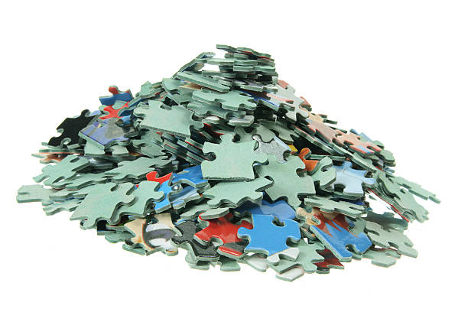
Models
Structure that we impose on the world.
All models are wrong, but some are useful.
Last time! Regression = “fitting a linear model”
Low-degree models
Deep neural networks
...
“The universe is a uniform void.”
Linear models
“Chaos! We can’t do anything!”
Sparse/Low-rank models
Universe
Simple
Complex

Slide 16
Today: SVD/PCA
PCA = “Principal Component Analysis”
SVD = “Singular Value Decomposition”
Mathematically, these are basically the same thing.
Technically, different types/parts of speech:
SVD is a mathematical thing that you do to a matrix
PCA is a type of a analysis
SVD can be used on data for analyzing it with PCA
We might use them interchangeably...sorry...

Slide 17
Just like regression... PCA fits a model
We need to answer:
What is the model?
When is it reasonable?
How do we fit the model?
How do we interpret the model once it is fit?

Slide 18
Recap for regression
If we want we can throw in some higher powers or interaction terms. Some people would call this a “polynomial model” or a “low-degree model.”
We need to answer:
What is the model?
When is it reasonable?
How do we fit the model?
How do we interpret the model once it is fit?
Linear model! $Y_{j}≈a+bD_{j}+cX_{j}^{\left(1\right)}+dX_{j}^{\left(2\right)}+⋯$
The “effect” of each variable is about the same for everybody.
The effects of different variables add up separately
...
Find the coefficients a,b,c,... that “best explain” the data.
Very carefully!
We can use it to do prediction if R² is big
If we want to get causal, b is the ATE.

Slide 19
Now, for PCA
We need to answer:
What is the model?
When is it reasonable?
How do we fit the model?
How do we interpret the model once it is fit?

Slide 20
The Model

Slide 21
Example for today
Returns to education!
Recommendation Engines / Collaborative Filtering
E.g., How do Netflix/Amazon/Goodreads/etc predict what you might like?
More generally, people having opinions about things

Slide 22

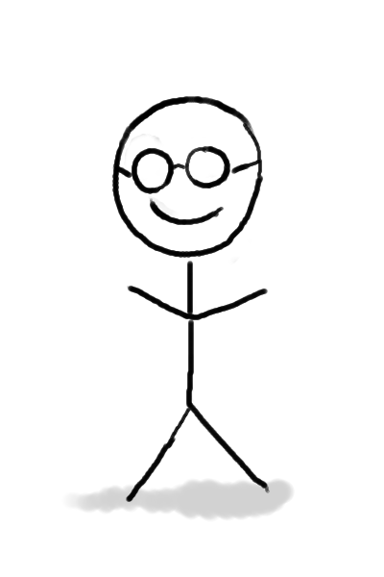
Setup
n people
m things they might have an opinion about
books, movies, ideas, laws, ...
-5 | -4 | 3 | 5
0 | -1 | 5 | 4
5 | 4 | -4.5 | -5
5 | 5 | 0 | 0
1 | 0 | -1 | 0

Slide 23
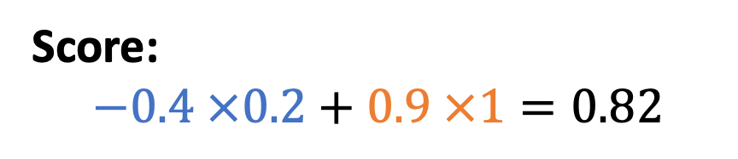



Model
*The length of u and v is sometimes called the “rank”.
Each person is represented by a short* vector, $v$
Each book is represented by a short* vector, $u$
How much that person likes that book is $v⋅u=\sum_{i}{u_{i}v_{i}}$
How much you like romance novels
How much you like sci-fi novels
How much romance is in the book
How much sci-fi is in the book
$$v=\left(−0.4, 0.9\right)$$
$$u=\left(0.2, 1\right)$$
Score:
$$−0.4 ×0.2+0.9 ×1=0.82$$

Slide 24
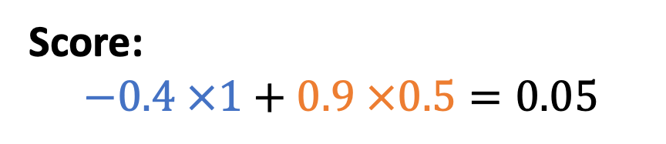

Model
*The length of u and v is sometimes called the “rank”.
Each person is represented by a short* vector, $v$
Each book is represented by a short* vector, $u$
How much that person likes that book is $v⋅u=\sum_{i}{u_{i}v_{i}}$
How much you like romance novels
How much you like sci-fi novels
How much romance is in the book
How much sci-fi is in the book
$$v=\left(−0.4, 0.9\right)$$
$$u=\left(1, 0.5\right)$$
Score:
$$−0.4 ×1+0.9 ×0.5=0.05$$

Slide 25
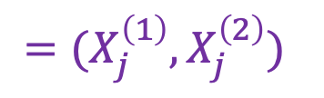


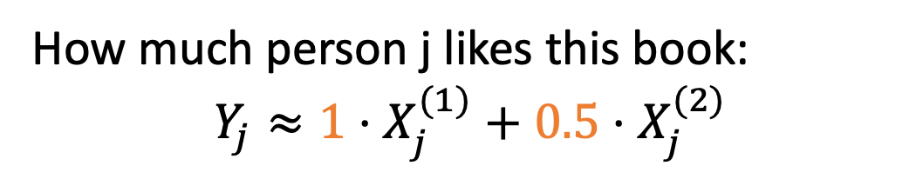
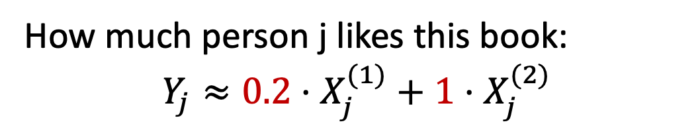
Aside: Relationship to regression
This is like the linear model for regression, but:
Each book has different coefficients
We’re not assuming that we know what each coordinate “represents”
We don’t observe the $X_{j}^{(1)},$even if we knew what they represented
$$v=\left(−0.4, 0.9\right)$$
How much person j likes this book:
$$Y_{j}≈0.2⋅X_{j}^{(1)}+1⋅X_{j}^{(2)}$$
$=(X_{j}^{\left(1\right)},X_{j}^{\left(2\right)})$
How much person j likes this book:
$$Y_{j}≈1⋅X_{j}^{(1)}+0.5⋅X_{j}^{(2)}$$
Person j

Slide 26









Model
Parameters of the model.
(These are unknown and we need to find them).
$$u_{1}$$
$$u_{2}$$
$$u_{3}$$
$$u_{4}$$
Can write it like this:
$$v_{1}$$
-5 | -4 | 3 | 5
0 | -1 | 5 | 4
5 | 4 | -4.5 | -5
5 | 5 | 0 | 0
1 | 0 | -1 | 0
$$v_{2}$$
$$v_{3}$$
$$v_{4}$$
$$v_{5}$$
Data (this is what we observe)

Slide 27









Another way to look at the model
$$u_{1}$$
$$u_{2}$$
$$u_{3}$$
$$u_{4}$$
$$v_{1}$$
$$v_{2}$$
$$v_{3}$$
How much person 3 likes book 2
$$v_{4}$$
$$v_{5}$$

Slide 28









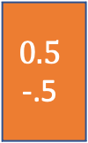
Another way to look at the model
$$1$$
0
$$0.5$$
0.5
$$0.5$$
-.5
$$0$$
1
$$0.1, −.2$$
$$0.9, 0.8$$
$$−.5, 0.5$$
0
How much person 3 likes book 2
$$0.1, 0.6$$
$$−0.5∗0.5+0.5 ∗0.5=0$$
$$−.4, 0.2$$

Slide 29
Another way to look at the model
$$1$$
0
$$0.5$$
0.5
$$0.5$$
-.5
$$0$$
1
-.5 | 0 | -.5 | .5
$$0.1, −.2$$
$$0.9, 0.8$$
$$−.5, 0.5$$
$$0.1, 0.6$$
$$−.4, 0.2$$

Slide 30







Another way to look at the model
$1$ 0.5 0.5 0
$0$ 0.5 -0.5 1
-.5 | 0 | -.5 | .5
This person’s preferences are given by:
$$0.1, −.2$$
$$0.9, 0.8$$
$$−0.5 ×$$
$1$ 0.5 0.5 0
$$−.5, 0.5$$
$$+$$
$$0.1, 0.6$$
$$0.5 ×$$
$0$ 0.5 -0.5 1
$$−.4, 0.2$$

Slide 31


Another way to look at the model
$1$ 0.5 0.5 0
$0$ 0.5 -0.5 1
-.5 | 0 | -.5 | .5
This person’s preferences are given by:
$$0.1, −.2$$
$$0.9, 0.8$$
$$0.9 ×$$
$1$ 0.5 0.5 0
$$−.5, 0.5$$
$$+$$
$$0.1, 0.6$$
$$0.8 ×$$
$0$ 0.5 -0.5 1
$$−.4, 0.2$$

Slide 32
Another way to look at the model
$1$ 0.5 0.5 0
$0$ 0.5 -0.5 1
0.9 | .85 | .05 | 0.8
-.5 | 0 | -.5 | .5
This person’s preferences are given by:
$$0.1, −.2$$
$$0.9, 0.8$$
$$0.9 ×$$
$1$ 0.5 0.5 0
$$−.5, 0.5$$
$$+$$
$$0.1, 0.6$$
$$0.8 ×$$
$0$ 0.5 -0.5 1
$$−.4, 0.2$$

Slide 33




Another way to look at the model
This type of person likes the first book a lot, the middle ones okay, and the last one less.
(Maybe they care only about the “romance” aspect of the book).
$1$ 0.5 0.5 0
$0$ 0.5 -0.5 1
0.9 | .85 | .05 | 0.8
-.5 | 0 | -.5 | .5
Each person is some combination of these two “types”:
$$0.1, −.2$$
$$0.9, 0.8$$
$$a ×$$
$1$ 0.5 0.5 0
$$−.5, 0.5$$
$$+$$
$$0.1, 0.6$$
$$b ×$$
$0$ 0.5 -0.5 1
$$−.4, 0.2$$

Slide 34
Now, for PCA
We need to answer:
What is the model?
When is it reasonable?
How do we fit the model?
How do we interpret the model once it is fit?

Slide 35
When is the model reasonable?

Slide 36














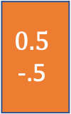

Discuss
When is this model “reasonable”?
What assumptions about the world is it imposing?
Each person and each book is a vector
Each person is a combination of “types”
$$1$$
0
$$0.5$$
0.5
$$0.5$$
-.5
$$0$$
1
$1$ 0.5 0.5 0
$0$ 0.5 -0.5 1
-.5 | 0 | 0 | .5
-.5 | 0 | 0 | .5
$$0.1, −.2$$
$$0.1, −.2$$
$$0.9, 0.8$$
$$0.9, 0.8$$
Or equivalently
$$−.5, 0.5$$
$$−.5, 0.5$$
$$0.1, 0.6$$
$$0.1, 0.6$$
$$−.4, 0.2$$
$$−.4, 0.2$$

Slide 37
Glib answer
We’re in prediction-land now.
The model is “reasonable” when it can predict the data well!

Slide 38
More thoughtful answer
Compared to regression
This model assumes:
Like regression: For each book, how much person j likes it depends linearly on a few things.
How much person j likes romance novels
How much person j likes sci-fi novels
Unlike regression: we don’t need to assume that we observe those things, or even know what they are.
Similar strong “structural” assumptions about how the world works.
In this model, we can get away with weaker assumptions about what we know/observe.

Slide 39
Now, for PCA
We need to answer:
What is the model?
When is it reasonable?
How do we fit the model?
How do we interpret the model once it is fit?

Slide 40
Fitting the Model

Slide 41





Let’s think about this geometrically
The model says that each person is a combination of “types”
We need to learn:
What those types are
What combination of each of them each person is
$$a ×$$
$1$ 0.5 0.5 0
$$+$$
$$b ×$$
$0$ 0.5 -0.5 1
Start with this one

Slide 42
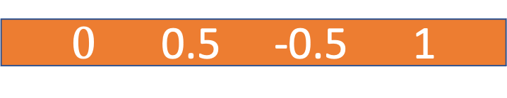
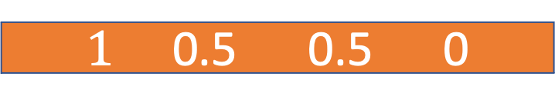
Suppose we know what the types are
These ones:
$1$ 0.5 0.5 0
$0$ 0.5 -0.5 1

Slide 43
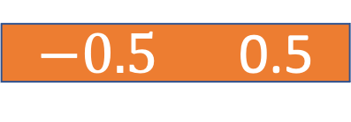
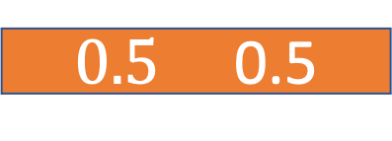
Suppose we know what the types are
Actually these ones, to make plotting easier...
$0.5$ 0.5
$−0.5$ 0.5
(-0.5, 0.5)
(0.5, 0.5)

Slide 44


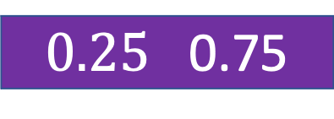
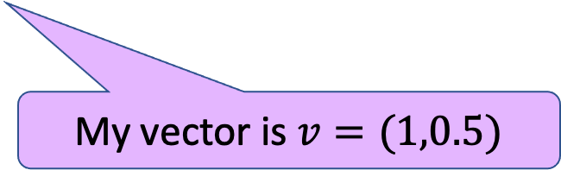

Suppose we know what the types are
Everyone is a combination of these:
$$1×$$
$0.5$ 0.5
$$+$$
...plus 0.5 times the second vector
$$.5 ×$$
$−0.5$ 0.5
(-0.5, 0.5)
(0.5, 0.5)
1 times the first vector...
$0.25$ 0.75
My vector is $v=(1,0.5)$

Slide 45



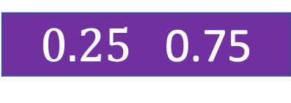

Suppose we know what the types are
Given how much a person likes each book, what’s that person’s $v$ vector?
?? $×$
$0.5$ 0.5
$$+$$
?? $×$
$−0.5$ 0.5
(-0.5, 0.5)
(0.5, 0.5)
$$+$$
$0.25$ 0.75

Slide 46
Suppose we know what the types are
Given how much a person likes each book, what’s that person’s $v$ vector?
?? $×$
$0.5$ 0.5
$$+$$
?? $×$
$−0.5$ 0.5
(-0.5, 0.5)
(0.5, 0.5)
1 times the first vector...
0.5 times the second vector
$$+$$
$0.25$ 0.75

Slide 47
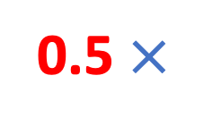
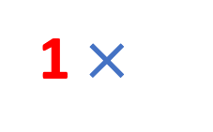

Suppose we know what the types are
Given how much a person likes each book, what’s that person’s $v$ vector?
1 $×$
$0.5$ 0.5
$$+$$
0.5 $×$
$−0.5$ 0.5
(-0.5, 0.5)
(0.5, 0.5)
1 times the first vector...
0.5 times the second vector
$$+$$
$0.25$ 0.75
My vector is $v=(1, 0.5)$

Slide 48
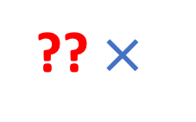
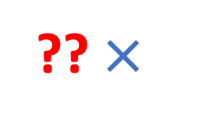
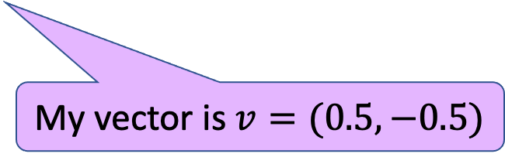
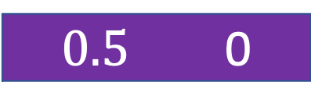
Practice
Given how much a person likes each book, what’s that person’s $v$ vector?
?? $×$
$0.5$ 0.5
$$+$$
?? $×$
$−0.5$ 0.5
(-0.5, 0.5)
(0.5, 0.5)
0.5 times the first vector...
$$+$$
$0.5$ 0
My vector is $v=(0.5, −0.5)$
-0.5 times the second vector

Slide 49
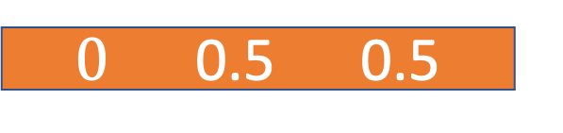
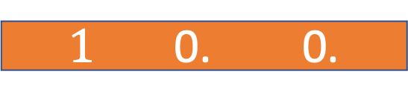
In more than 2 dimensions...
$1$ 0. 0.
$0$ 0.5 0.5
.5
1
.5

Slide 50



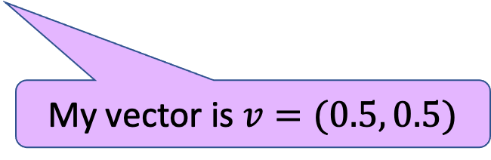

In more than 2 dimensions...
$$.5 ×$$
$1$ 0. 0.
$$+$$
$$.5 ×$$
$0$ 0.5 0.5
.5
... Plus 0.5 times the second vector
.5
1
$0.5$ 0.25 0.25
.25
0.5 times the first vector...
.5
My vector is $v=(0.5, 0.5)$

Slide 51



In more than 2 dimensions...
$$??? ×$$
$1$ 0. 0.
$$+$$
$$??? ×$$
$0$ 0.5 0.5
0.5 times the second vector!
.5
.5
1
$0.5$ 0.25 0.25
.25
0.5 times the first vector!
.5
My vector is $v=(0.5, 0.5)$

Slide 52


In more than 2 dimensions...
$$.5 ×$$
$1$ 0. 0.
$$+$$
$$.5 ×$$
$0$ 0.5 0.5
0.5 times the second vector!
.5
.5
1
$0.5$ 0.25 0.25
.25
0.5 times the first vector!
.5
My vector is $v=(0.5, 0.5)$

Slide 53
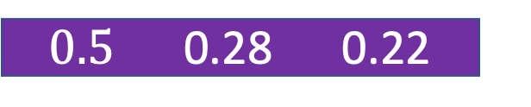


What if there’s no exact fit?
Just like with regression, find the coefficients that are the best fit for the data!
Geometrically, project onto the span of the “types” and use that point.
$$? ×$$
$1$ 0. 0.
$$+$$
Pretend we actually have this point, and do what we did before.
$$? ×$$
$0$ 0.5 0.5
.5
.5
1
$0.5$ 0.28 0.22
.25
.5

Slide 54
How do we fit the model?
BACK TO THIS SLIDE
The model says that each person is a combination of “types”
We need to learn:
What those types are
What combination of each of them each person is
$$a ×$$
$1$ 0.5 0.5 0
$$+$$
$$b ×$$
$0$ 0.5 -0.5 1
“Project” onto each type

Slide 55
How do we fit the model?
The model says that each person is a combination of “types”
We need to learn:
What those types are
What combination of each of them each person is
$$a ×$$
$1$ 0.5 0.5 0
$$+$$
$$b ×$$
$0$ 0.5 -0.5 1
What are the “types”?

Slide 56



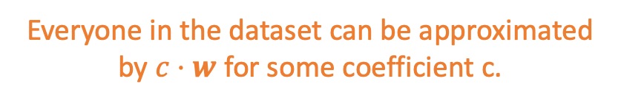
Suppose the data look like this
Discuss: If you only get one “type” to model the data, what ”type” would you choose?
That is, you get one vector, and you have to describe all the people in terms of that vector.
How much you like the yellow book
This person is $≈\frac{1}{2}⋅w$
$$w$$
How much you like the red book
The type of person who really likes the red book and is agnostic about the yellow.
This person is $≈−1⋅w$
Everyone in the dataset can be approximated by $c⋅w$ for some coefficient c.

Slide 57



Suppose the data look like this
Discuss: If you only get one “type” to model the data, what ”type” would you choose?
How much you like the yellow book
This person is $≈−1⋅w$
This person is $≈\frac{1}{2}⋅w$
How much you like the red book
The type of person who likes the red book and dislikes the yellow book.
$$w$$

Slide 58
How should we choose multiple “types”?
At this point Mary will attempt to draw a 3D picture on the board...

Slide 59
How to identify the “types”
Find the direction that “best explains” the variance in the data.
That’s our first type!
Then find the direction that “best explains” the remaining variance.
That’s our second type!
Etc.
Each “type” represents a “controversial direction.”
The first one is the most controversial
The second one is the second-most controversial
Etc.

Slide 60
How do we fit the model?
BACK TO THIS SLIDE
The model says that each person is a combination of “types”
We need to learn:
What those types are
What combination of types each person is
$$a ×$$
$1$ 0.5 0.5 0
$$+$$
$$b ×$$
$0$ 0.5 -0.5 1
These types are called the “principal vectors” or “right singular vectors”
They are the directions that capture the most variance
Aka the combinations of likes/dislikes that are the most “controversial”
The coefficients for each person are called the “principal components”
Use geometry

Slide 61

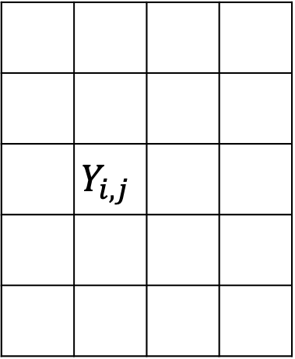
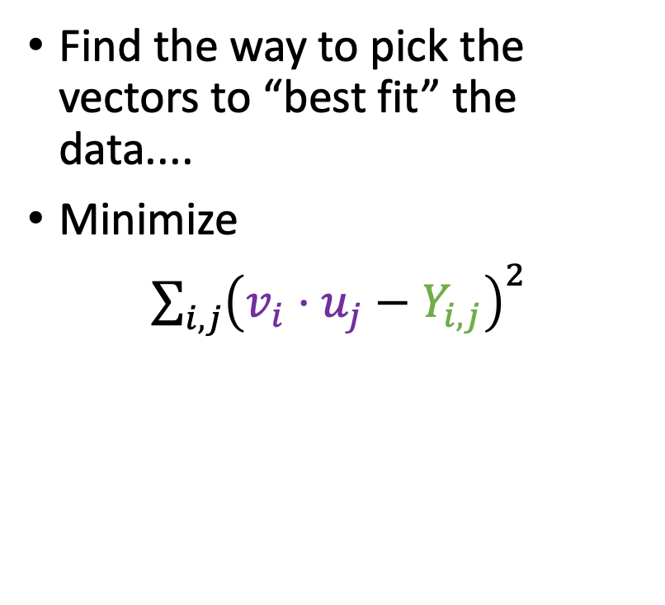

Mathematically Equivalently But not as useful for our “interpretation” step later..
Book j
Find the way to pick the vectors to “best fit” the data....
Minimize
$\sum_{i,j}{{\left(v_{i}⋅u_{j}−Y_{i,j}\right)}^{2}}$
Parameters of the model.
(These are unknown and we need to find them).
$$u_{j}$$
 | $$Y_{i,j}$$
Value the model would predict
Actual value
$$v_{i}$$
Person i
It turns out this will give you the same* thing!
*For some definitions of “same”

Slide 62



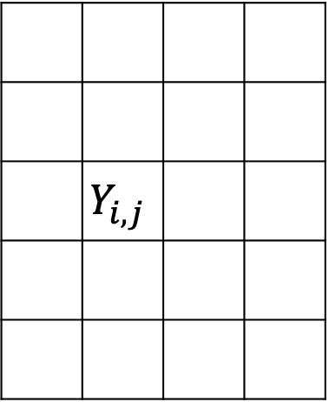



Also mathematically equivalently Ignore this slide if you haven’t seen matrix multiplication before...
You can write any matrix uniquely as:
 | $$Y_{i,j}$$
$$σ_{1}$$
$$σ_{2}$$
$$σ_{3}$$
=
$$σ_{4}$$
Diagonal matrix with
$σ_{1}≥σ_{2}≥⋯≥0$
Matrix with orthonormal rows
Matrix with orthonormal columns
This is called the “Singular Value Decomposition” (SVD)

Slide 63
Also mathematically equivalently Ignore this slide if you haven’t seen matrix multiplication before...
You can approximate any matrix as:
 | $$Y_{i,j}$$
$$σ_{1}$$
$$σ_{2}$$
$$σ_{3}$$
=
$$σ_{4}$$
Diagonal matrix with
$σ_{1}≥σ_{2}≥⋯≥0$
Matrix with orthonormal rows
Matrix with orthonormal columns

Slide 64





Also mathematically equivalently Ignore this slide if you haven’t seen matrix multiplication before...
You can approximate any matrix as:
These are our “types” of books
 | $$Y_{i,j}$$
This is person j’s vector
$$σ_{1}$$
$$σ_{2}$$
$$σ_{3}$$
=
$$σ_{4}$$
Diagonal matrix with
$σ_{1}≥σ_{2}≥⋯≥0$
Matrix with orthonormal rows
Matrix with orthonormal columns

Slide 65
Now, for PCA
We need to answer:
What is the model?
When is it reasonable?
How do we fit the model?
How do we interpret the model once it is fit?

Slide 66
Interpreting the Model

Slide 67
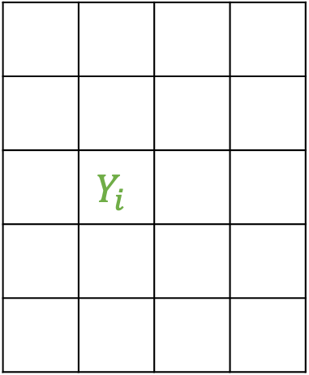
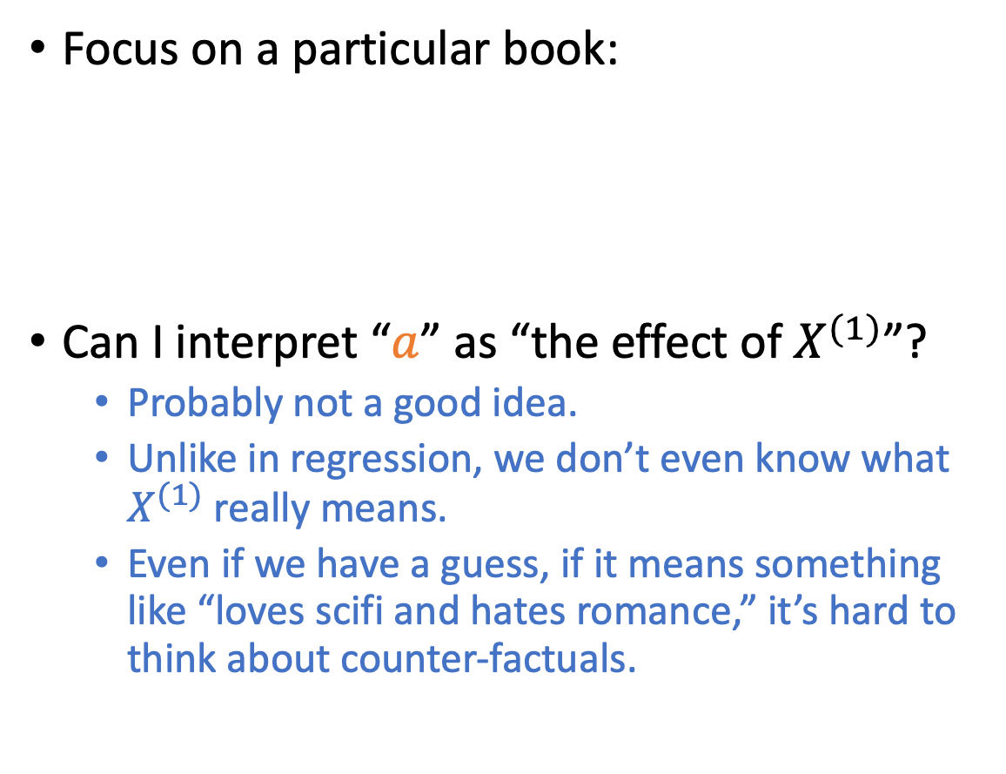



Can we interpret this causally? It looks kinda like regression...
Book
Focus on a particular book:
Can I interpret “$a$” as “the effect of $X^{(1)}$”?
Probably not a good idea.
Unlike in regression, we don’t even know what $X^{(1)}$ really means.
Even if we have a guess, if it means something like “loves scifi and hates romance,” it’s hard to think about counter-factuals.
$$Y_{i}≈aX_{i}^{\left(1\right)}+bX_{i}^{(2)}$$
We fit these parameters
$$a$$
$$b$$
How much person i likes this book
 | $$Y_{i}$$
$$X_{i}^{(1)} X_{i}^{(2)}$$
Person i

Slide 68
Interpreting the principal vectors
The principal vectors are the “types” that we identified.
They tell us what the most “important” axes are.
Think: If you had to ask someone just a few questions to learn about them, what would you ask?
About -1!
On a scale from -1 to 1, how much do you agree with “I like the red book and dislike the yellow book”?
About ½!

Slide 69
Example
World Values Survey

Slide 70
World Values Survey
US Survey: 2017
Turkish survey: 2018
Ask folks from a bunch of different countries a bunch of different questions about what they value.
E.g., On a scale from 1 (never justified) to 10 (always justified):
Claiming government benefits to which you are not entitled
Avoiding fare on public transit
Cheating on taxes
Taking bribes
Homosexuality
Abortion
Sex before Marriage
Casual sex
Divorce
Discuss:
Which do you think would be the most polarizing in the US and/or in Turkey?
Which single question?
Which “type” explains the most variance? (recall that a “type” is a combination of multiple questions)

Slide 71
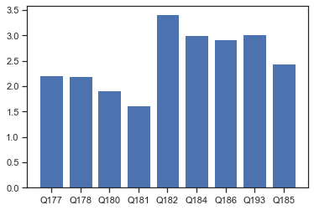
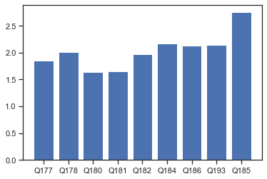
Which single issue has the most variance?
US Standard Deviations:
Türkiye Standard Deviations:
Benefits
Transit
Benefits
Taxes
Transit
Bribes
Abortion
Taxes
Bribes
Abortion
Divorce
Casual sex
Divorce
Pre-marital sex
Casual sex
Pre-marital sex
Homosexuality
Homosexuality

Slide 72
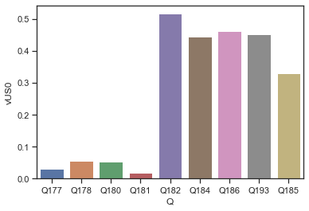
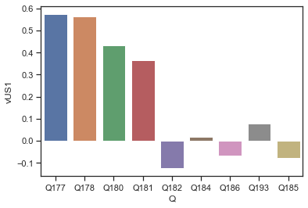
Top “types” in the US
Discuss: How do you interpret this?
Benefits
Transit
Taxes
Bribes
Abortion
Divorce
Casual sex
Pre-marital sex
Benefits
Transit
Taxes
Bribes
Abortion
Divorce
Casual sex
Homosexuality
Pre-marital sex
Homosexuality

Slide 73
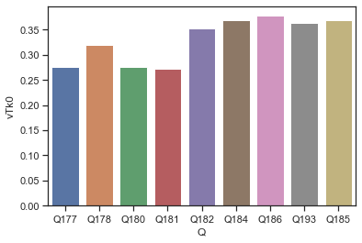
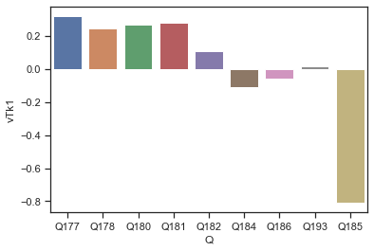
Top “types” in Türkiye
Discuss: How do you interpret this?
How is this different than the US?
Benefits
Transit
Benefits
Taxes
Transit
Bribes
Abortion
Taxes
Divorce
Bribes
Abortion
Casual sex
Divorce
Pre-marital sex
Casual sex
Pre-marital sex
Homosexuality
Homosexuality

Slide 74
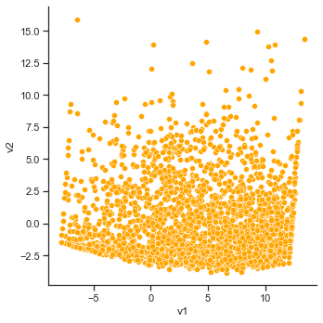
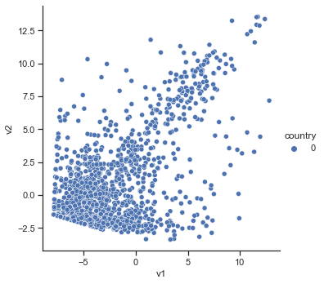
Visualizing the data projected onto the top two US “types”
US data:
Türkiye data:
More okay with cheating the government
More okay with cheating the government
Less “socially conservative”
Less “socially conservative”

Slide 75
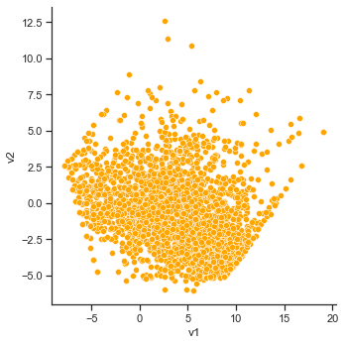
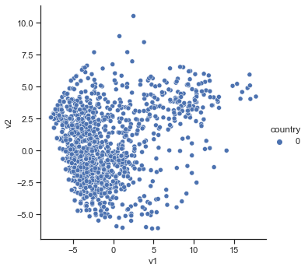
Visualizing the data projected onto the top two Turkish “types”
US data:
Turkish data:
More against divorce
More against divorce
Less okay with cheating the government and sex
Less okay with cheating the government and sex

Slide 76
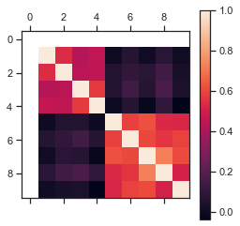
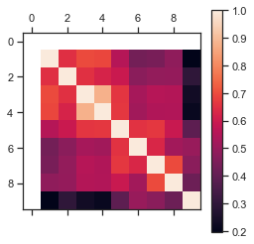
Sanity Check: Correlation Matrices
US
Turkey
Benefits
Transit
Taxes
Bribes
Abortion
Benefits
Divorce
Transit
Casual sex
Taxes
Pre-marital sex
Bribes
Abortion
Divorce
Casual sex
Pre-marital sex
Homosexuality
Homosexuality

Slide 77
Take-aways
We can learn about the important “types” by looking at PCA/SVD
The different “types” might be different in different countries!
In the US, the “no-cheating-the-government” types and the “socially conservative” types might be different.
In Turkey, these tend to be the same “type”, except for the issue of divorce

Slide 78
If time, dealing with Missing Data

Slide 79
Canonical example of PCA/SVD
Predicting preferences
E.g., “Netflix Challenge”
Aka, you don’t have complete data...
? | -4 | ? | ?
0 | ? | 5 | ?
5 | ? | ? | -5
? | 5 | 0 | 0
1 | 0 | ? | ?
What to do?

Slide 80
Canonical example of PCA/SVD
Predicting preferences
E.g., “Netflix Challenge”
Aka, you don’t have complete data...
Also, data is pretty quantized
Sometimes just “Like/Didn’t like”
? | -4 | ? | ?
0 | ? | 5 | ?
5 | ? | ? | -5
? | 5 | 0 | 0
1 | 0 | ? | ?

Slide 81
Canonical example of PCA/SVD
Predicting preferences
E.g., “Netflix Challenge”
Aka, you don’t have complete data...
Also, data is pretty quantized
Sometimes just “Like/Didn’t like”
? | + | ? | ?
- | ? | + | ?
+ | ? | ? | -
? | + | - | +
+ | - | ? | ?
What to do?

Slide 82
Dealing with incomplete data
Buzzword: “low-rank matrix completion”
It turns out that you can (sometimes) do this!
See, e.g., [Candés, Recht, 2009] and many follow-ups

Slide 83
Challenges
There are “missing” patterns that make the task impossible.
? | -4 | ? | ?
0 | ? | 5 | ?
5 | ? | ? | -5
? | 5 | 0 | 0
1 | 0 | ? | ?

Slide 84
Challenges
There are “missing” patterns that make the task impossible.
? | -4 | ? | ?
0 | ? | 5 | ?
? | ? | ? | ?
? | 5 | 0 | ?
1 | 0 | ? | ?

Slide 85
Challenges
There are “missing” patterns that make the task impossible.
Even if the task is possible, it is no longer (as obviously) computationally feasible.
Task: Find the vectors for people and books to minimize sum-squared error.
There are many efficient algorithms if you have all the data.
When you don’t have all the data, these algorithms don’t work correctly.
? | -4 | ? | ?
0 | ? | 5 | ?
5 | ? | ? | -5
? | 5 | 0 | 0
1 | 0 | ? | ?
We don’t even have any complete data points to plot!

Slide 86
Challenge 1: Some “missing” patterns are impossible
Solution 1: Assume/hope the “missing” patterns are random.
There are algorithms that provably work given this assumption.
[Candes, Recht, 2009], [Keshavan, Montanari, Oh, 2010], [Candes, Plan 2010], [Recht 2011], ...
The algorithms work well in practice for some applications.
Solution 2: Recover “as much as you can” given the “missing” pattern that you do have.
E.g., if we are missing lots of data for a person, we know we can’t learn much about that person.
[Foygel, Srebro 2011], [Bhojanapalli, Jain 2014], [Lee, Shraibman 2013], [Foucart, Needell, Pathak, Plan, W. 2020]

Slide 87



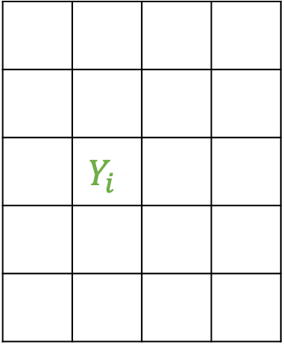
Challenge 2: Doing this efficiently
Book
Here’s one algorithm that works pretty well:
Focus on a particular book:
Just like regression!
Pick arbitrary values for the people, and use regression to get coefficients for each book.
We need fit these parameters
$$a$$
$$b$$
$$Y_{i}≈aX_{i}^{\left(1\right)}+bX_{i}^{(2)}$$
 | $$Y_{i}$$
How much person i likes this book
$$X_{i}^{(1)} X_{i}^{(2)}$$
Person i

Slide 88

Challenge 2: Doing this efficiently
Book
Here’s one algorithm that works pretty well:
Focus on a particular book:
Just like regression!
Pick arbitrary values for the people, and use regression to get coefficients for each book.
We need fit these parameters
$$a$$
$$b$$
$$Y_{i}≈aX_{i}^{\left(1\right)}+bX_{i}^{(2)}$$
 | $$Y_{i}$$
How much person i likes this book
$$X_{i}^{(1)} X_{i}^{(2)}$$
Person i

Slide 89




Challenge 2: Doing this efficiently
Book j
Here’s one algorithm that works pretty well:
Focus on a particular person:
Just like regression!
Use the values we just found for the books, and use regression to get coefficients for each person.
We need fit these parameters
$$Z_{j}^{(1)}$$
$$Z_{j}^{(2)}$$
$$Y_{j}≈cZ_{j}^{\left(1\right)}+dZ_{j}^{(2)}$$
 | $$Y_{j}$$
How much this person likes book j
$$c d$$
Person

Slide 90

Challenge 2: Doing this efficiently
Book j
Here’s one algorithm that works pretty well:
Focus on a particular person:
Just like regression!
Use the values we just found for the books, and use regression to get coefficients for each person.
We need fit these parameters
$$Z_{j}^{(1)}$$
$$Z_{j}^{(2)}$$
$$Y_{j}≈cZ_{j}^{\left(1\right)}+dZ_{j}^{(2)}$$
 | $$Y_{j}$$
How much this person likes book j
$$c d$$
Person

Slide 91

Challenge 2: Doing this efficiently
Book
Here’s one algorithm that works pretty well:
Focus on a particular book:
Just like regression!
Pick arbitrary values for the people, and use regression to get coefficients for each book.
We need fit these parameters
$$a$$
$$b$$
$$Y_{i}≈aX_{i}^{\left(1\right)}+bX_{i}^{(2)}$$
 | $$Y_{i}$$
How much person i likes this book
$$X_{i}^{(1)} X_{i}^{(2)}$$
Person i

Slide 92

Challenge 2: Doing this efficiently
Book
Here’s one algorithm that works pretty well:
Focus on a particular book:
Just like regression!
Pick arbitrary values for the people, and use regression to get coefficients for each book.
We need fit these parameters
$$a$$
$$b$$
$$Y_{i}≈aX_{i}^{\left(1\right)}+bX_{i}^{(2)}$$
 | $$Y_{i}$$
How much person i likes this book
$$X_{i}^{(1)} X_{i}^{(2)}$$
Person i

Slide 93

Challenge 2: Doing this efficiently
Book j
Here’s one algorithm that works pretty well:
Focus on a particular person:
Just like regression!
Use the values we just found for the books, and use regression to get coefficients for each person.
We need fit these parameters
$$Z_{j}^{(1)}$$
$$Z_{j}^{(2)}$$
$$Y_{j}≈cZ_{j}^{\left(1\right)}+dZ_{j}^{(2)}$$
 | $$Y_{j}$$
How much this person likes book j
$$c d$$
Person

Slide 94

Challenge 2: Doing this efficiently
Book j
Here’s one algorithm that works pretty well:
Focus on a particular person:
Just like regression!
Use the values we just found for the books, and use regression to get coefficients for each person.
We need fit these parameters
$$Z_{j}^{(1)}$$
$$Z_{j}^{(2)}$$
$$Y_{j}≈cZ_{j}^{\left(1\right)}+dZ_{j}^{(2)}$$
 | $$Y_{j}$$
How much this person likes book j
$$c d$$
Person

Slide 95

Challenge 2: Doing this efficiently
Book
Here’s one algorithm that works pretty well:
Focus on a particular book:
Just like regression!
Pick arbitrary values for the people, and use regression to get coefficients for each book.
We need fit these parameters
$$a$$
$$b$$
$$Y_{i}≈aX_{i}^{\left(1\right)}+bX_{i}^{(2)}$$
 | $$Y_{i}$$
How much person i likes this book
$$X_{i}^{(1)} X_{i}^{(2)}$$
Person i

Slide 96

Challenge 2: Doing this efficiently
Book
Here’s one algorithm that works pretty well:
Focus on a particular book:
Just like regression!
Pick arbitrary values for the people, and use regression to get coefficients for each book.
We need fit these parameters
$$a$$
$$b$$
$$Y_{i}≈aX_{i}^{\left(1\right)}+bX_{i}^{(2)}$$
 | $$Y_{i}$$
How much person i likes this book
$$X_{i}^{(1)} X_{i}^{(2)}$$
Person i

Slide 97

Challenge 2: Doing this efficiently
Book j
Here’s one algorithm that works pretty well:
Focus on a particular person:
Just like regression!
Use the values we just found for the books, and use regression to get coefficients for each person.
We need fit these parameters
$$Z_{j}^{(1)}$$
$$Z_{j}^{(2)}$$
$$Y_{j}≈cZ_{j}^{\left(1\right)}+dZ_{j}^{(2)}$$
 | $$Y_{j}$$
How much this person likes book j
$$c d$$
Person

Slide 98

Challenge 2: Doing this efficiently
Book j
Here’s one algorithm that works pretty well:
Focus on a particular person:
Just like regression!
Use the values we just found for the books, and use regression to get coefficients for each person.
We need fit these parameters
$$Z_{j}^{(1)}$$
$$Z_{j}^{(2)}$$
$$Y_{j}≈cZ_{j}^{\left(1\right)}+dZ_{j}^{(2)}$$
 | $$Y_{j}$$
How much this person likes book j
$$c d$$
Person

Slide 99

Challenge 2: Doing this efficiently
Book
Here’s one algorithm that works pretty well:
Keep repeating this until you converge.
This algorithm is called “alternating minimization”
One can prove it works well under mild assumptions.
[Jain, Netrapalli, Sanghavi 2013]
[Hardt, 2014]
...
We need fit these parameters
$$a$$
$$b$$
 | $$Y_{i}$$
$$X_{i}^{(1)} X_{i}^{(2)}$$
Person i

Slide 100
Wrapping up

Slide 101

Recap
Book
Singular Value Decomposition (SVD) and Principal Component Analysis (PCA) fit a model.
We can interpret the “principal vectors” in this model as “types of people”
In the model, everyone is a combination of these types (or their opposites).
We need fit these parameters
 | $$4$$
Person

Slide 102
Next time
No class next week!
Enjoy the break!
In the meantime, start to think about your projects...
And do the optional HW5 if you want to practice SVD/PCA
Project proposals due Nov 21!
See you in two weeks!

